Slide 1

Health Status Prediction
2nd Iteration Presentation *Check notes for details
Notes:
Good evening, we're IT Girls – Sarah, Ruth, May, and Lily.

Slide 2
Agenda
Project Outline, Flow Chart, Team Plan
Dataset Cleansing/Merging [Dilemma]
Future Plan for Visualizations
Individual Statistical Analysis
Walkthrough of Team Notebook
Updated Github Repo
Notes:
Tonight, we'd like to quickly go through our project outline, flow chart, and team plan to give you an update on where we are in the process of completing this project. Next, we'll cover our dataset cleaning and merging, where Ruth will cover the issues we've run into while attempting to make our data usable. May and Lily will explain our future plans for visualizations, now that we've really started digging into our data. After that, we'll quickly share some of our findings in our individual explorations, as well as what our initial look at the merged data turned up. Finally, we'll show a brief tour of our updated GitHub repo.

Slide 3

Project Timeline
Week 1 (1/25-1/31)
Team formation
Create Project Charter
Week 2 (2/1-2/7)
Gather datasets
GitHub Repo
Formulate Hypothesis
Weeks 3 & 4 (2/8-2/21)
1st Iteration: Present Team Plan, Technologies, Collections, and GitHub Repo
Week 5 (2/22-2/28)
Performance, Scalability, and Efficiency
Work on Project Visualizations
Week 6 (3/1-3/7)
Look for Simple Patterns that Align to Project Goals
Week 7 & 8 (3/8-3/28)
2nd Iteration: Clean data collections, Insights/Patterns, Hypothesis, Tableau/Visualize
Weeks 9 & 10 (3/29-4/11)
Build a Predictive Model
Week 10 (4/12-4/25)
Final Project Demo
CREATE Symposium
Final Project Report
Assign Project Roles
Sarah Price
Notes:
As presented in our first presentation, here is our project timeline. At the current time, we have completed weeks 1-6, and are currently in Week 7 – our presentation on the initial pattern finding done in week 6. The remainder of the project will be focused on finding more patterns and creating interactive visualizations.

Slide 4
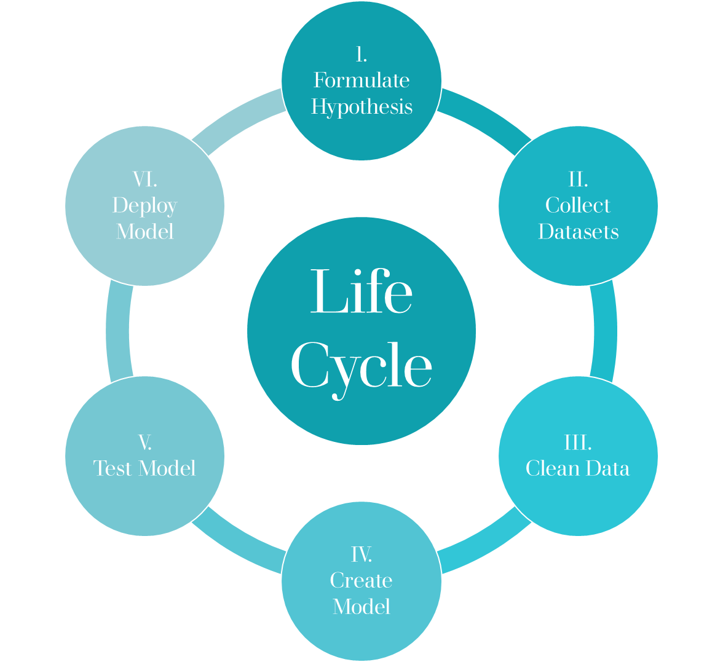
Flow Chart
We are here!
Sarah Price
Our Next Step!
Notes:
Since we're all familiar with the project life cycle, you can see that we have already formulated hypotheses, collected our dataset, and cleaned our data – which means we are now beginning the process of creating a model.

Slide 5
What We've Accomplished So Far...
Dilemma
Solutions
Team Plan!
Sarah Price
Notes:
1. For this iteration, we've run into a dilemma where we are unable to merge all four
of our datasets. Three of our datasets are low-level, while the fourth is high-level and
therefore incompatible with the rest. (Details could be explained by Ruth during the data modeling segment.)
2. After speaking to Dr. Anca, we've discussed several solutions:
-- try to combine based on common categories
-- connect categories logically
-- leave datasets separate in terms of the ones that will merge and the one that won't.
3. Going forward, our immediate goals are to find the most reasonable solution to our
merging dilemma, and since all of our hypotheses are single factor correlations, apply
PCA to each of them in order to determine how impactful each
factor is. In terms of time, we are still relatively on schedule. We plan on devoting our
lead-visualizers May and Lily to start working on our visualizations for the datasets that
are merged and ready to go.

Slide 6
Role Responsibilities:
Individual Effort
Team Effort
Going Foward
Sarah Price
Notes:
Individual Effort: Each of us completed our pre-processing of the data and an individual statistical analysis on our own datasets. We each formulated a hypothesis based on our findings from the initial exploration.
Team Effort: Each of us have been working in tandem to solve our merging dilemma and finding ways to effectively apply PCA to the datasets.
Going Forward: we each will have specific tasks related to our roles
Ruth (Data modeler): Lead on finding a solution to the merging dilemma.
May(data viz): Lead on determining best tools for visualization and getting started on some exploratory models.
Lily(data viz/scribe): Lead on keeping our data and files on Github update-to-date and assisting May on our preliminary visualizations.
Sarah (data anlyzer): Lead on applying PCA effectively and running regression on our hypotheses.

Slide 7
Data Modeling
Technologies
Merging Dilemma
Ruth Whitehouse
Notes:
Ruth:
-- Talk about the technologies we've used so far to accomplish data cleansing, statistical analysis, and merging. (I.e. Jupyter Notebook, Python Pandas, etc.)

Slide 8
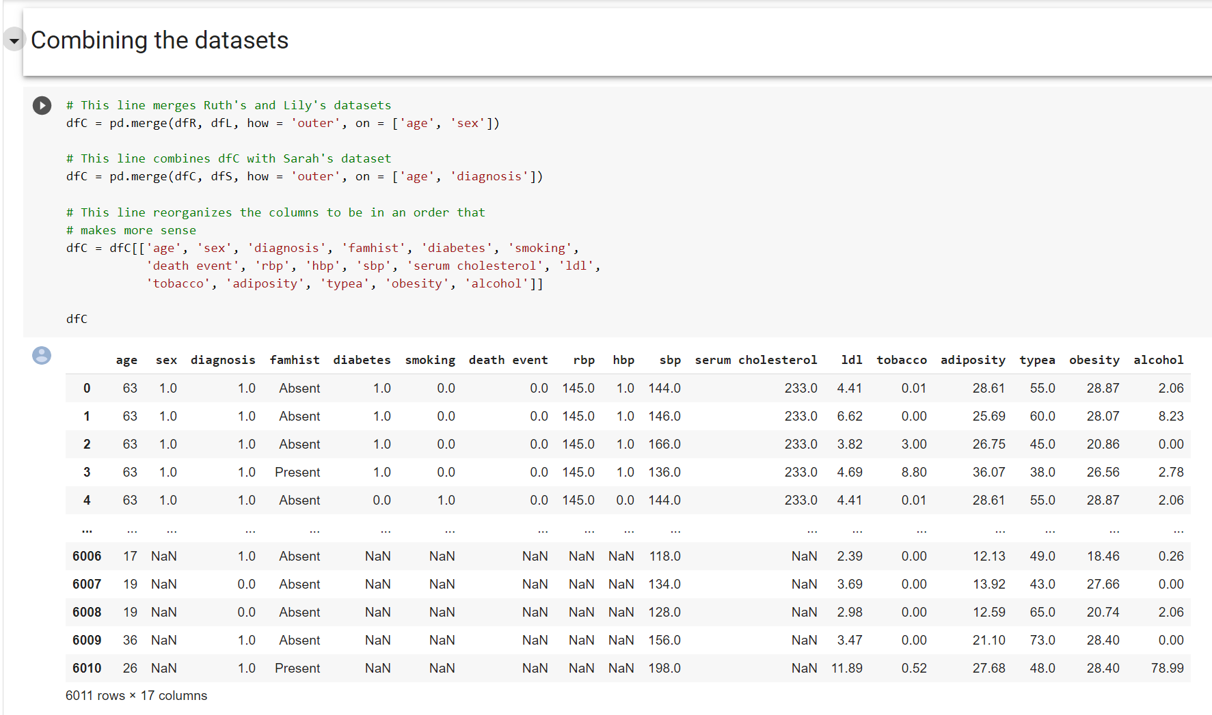
Team Notebook | In-progress
Ruth Whitehouse

Slide 9
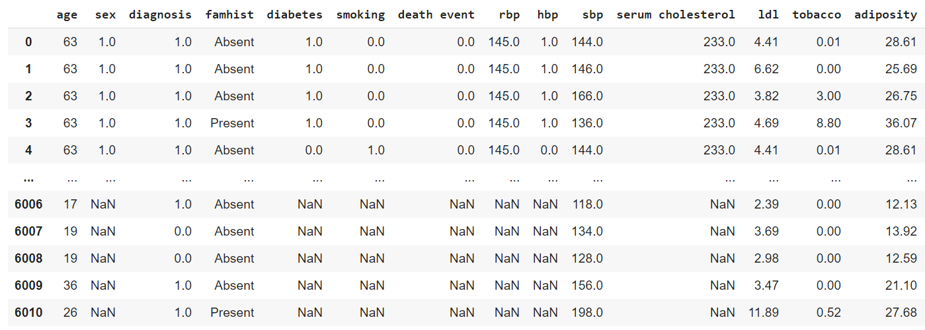
Merging Dilemma
This is what three of our datasets look like versus...
Ruth Whitehouse
Notes:
Ruth:
-- Explain the Dilemma and how we are approaching the issue. If necessary, mention why it is causing a small setback in our schedule.

Slide 10
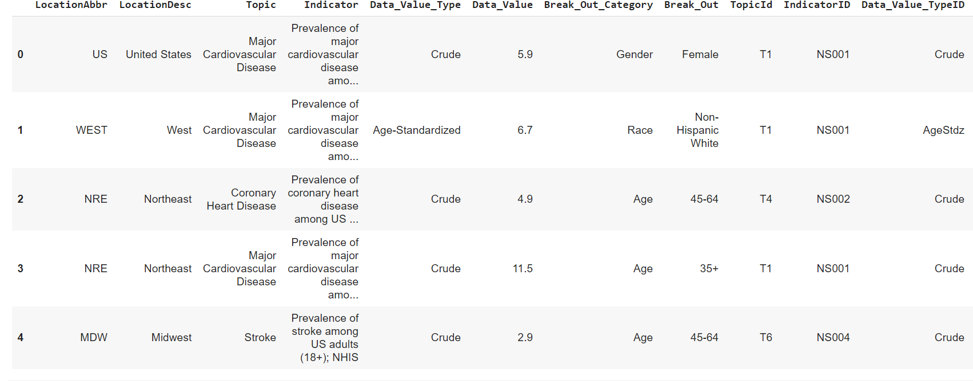
Ruth Whitehouse
Notes:
Ruth:
-- Talk about the technologies we've used so far to accomplish data cleansing, statistical analysis, and merging. (I.e. Jupyter Notebook, Python Pandas, etc.)
-- Explain the Dilemma and how we are approaching the issue. If necessary, mention why it is causing a small setback in our schedule.

Slide 11
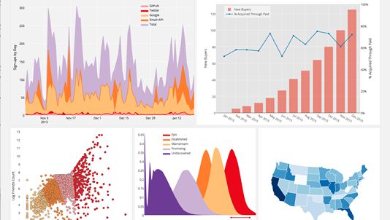
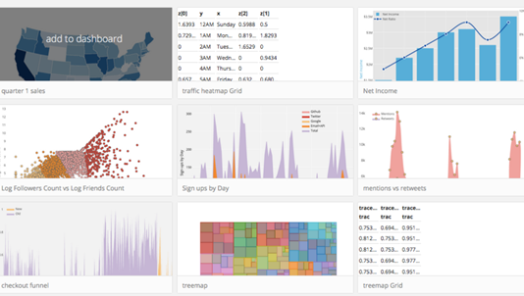
Plan for Visualization
Plotly
Tableau
May Kamreen

Slide 12
Individual Statistical Analysis

Slide 13
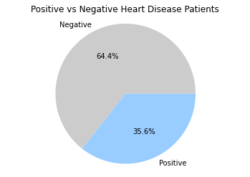
Individual Statistical Analysis | Sarah
To begin the analysis of my dataset, I started by looking at how many cases were heart disease positive vs heart disease negative.
Notes:
To begin my exploration, I first decided that I should determine the breakdown of how many patients in the study were heard disease positive, and how many were negative. As you can see in this chart, about 2/3 of the patients in the study were heart disease negative. This gives me a good control group for the risk factors included in the dataset.

Slide 14
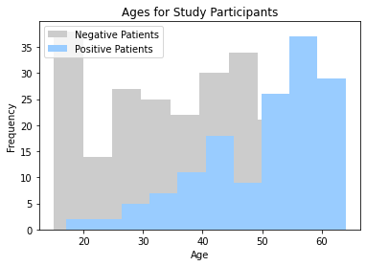
Individual Statistical Analysis | Sarah
I looked at age ranges for the participants in the study to determine whether there was any major difference between the heart disease positive and heart disease negative patients.
Notes:
I decided that I wanted to look at what the average ages of participants was to determine if there was a difference between the positive and negative patients. Because of the way the data was recorded, there was a slight nuance in the "age" category – negative patients showed their current age, while positive patients showed the age at onset. It turned out that the average age of the entire study was 43.4. This means that the heart disease positive patients were above average with a mean age of 50.5, while the heart disease negative patients were below average with a mean of 39.5.

Slide 15
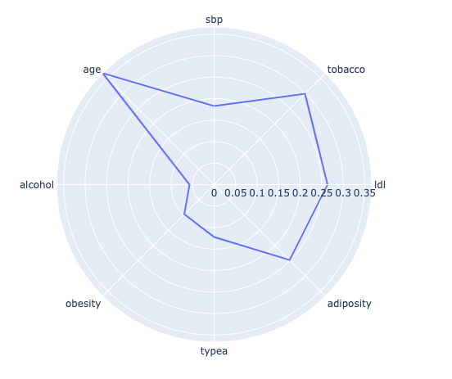
Individual Statistical Analysis | Sarah
To determine whether any of the factors included in my dataset had more of an impact on heart disease than others, I ran a correlation analysis using the df.corr() method included in the Python library.
Because of the results of this graph, we hypothesize that a person's age is a major contributor to their risk for heart disease.
Notes:
At the end of my analysis, to determine the importance of different factors, I used the df.corr() method included in the Python library. By running this against the entire dataframe, I was able to determine how closely each factor impacted the positivity of heart disease. As you can see, age appears to be the leading contributor to heart disease, although the R2 value was only .37.

Slide 16
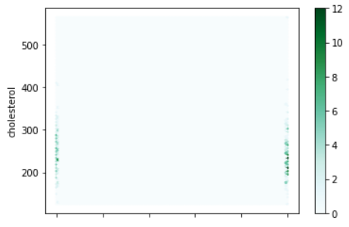
Individual Statistical Analysis | Ruth
I had a hypothesis that the higher a person's cholesterol, the more likely they are to have heart disease.
The chart to the left is a hexbin plot. The darker an area, the more of a relationship the two axis have to one another.
The right side of this graph is the side diagnosed with heart disease. The left side is the side that doesn't have heart disease.

Slide 17
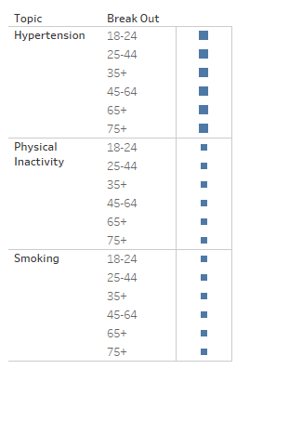
Individual Statistical Analysis | May
Hypothesis: People are more likely to suffer from cardiovascular diseases if they have hypertension out of the following risk categories: Hypertension, Physical inactivity, and Smoking

Slide 18

Individual Statistical Analysis | May
Types of Cardiovascular Diseases are distributed evenly within the Cardio Dataset

Slide 19
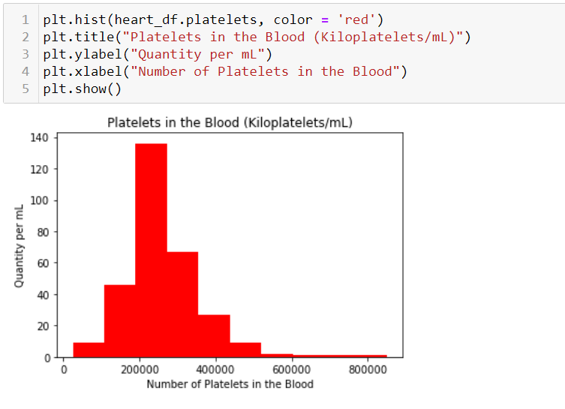
Blood Platelets
Possible Hypothesis
Valuable results relating to health.
Lily Sheppard
Notes:
Based on this graph, I would like to explore whether or not there is a correlation
between a patient's number of blood platelets and heart disease. Therefore,
I hypothesize that people with lower counts of blood platelets have a higher
risk of contracting heart disease.
The results of this graph are interesting, but not complete. It requires further
anlysis to determine whether or not high or low amounts of blood platelets
effect the risk of heart disease.

Slide 20
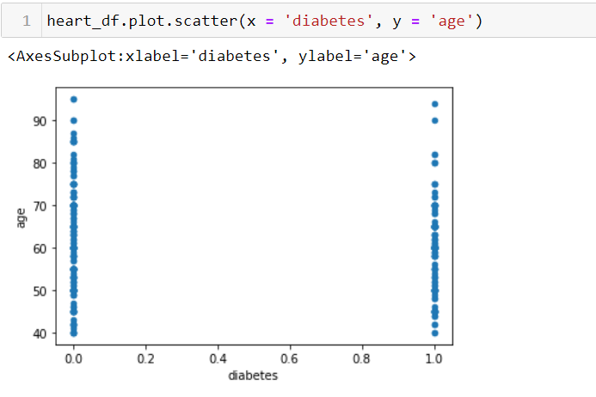
Age vs. Diabetes
Possible Hypothesis
Valuable results relating to health.
Lily Sheppard
Notes:
Now, based on this graph, I would like to hypothesize whether or not
there is a direct correlation between patients with diabetes and heart disease.
This graph already gives me some interesting data that I can narrow
down and focus on for further analysis. For example, there seems to
be a higher occurance of diabetes in particular ages across the spectrum.
Going forward, I need to do some additional clustering to extract that specific data.

Slide 21
Hypotheses
The higher the cholesterol, the more likely a person is to have heart disease
Older patients have a higher likelihood of being heart disease positive
There is a direct correlation between patients who have diabetes and those who have heart disease.
Using hypertension, physical inactivity, and smoking as risk factors, people are at the highest risk for cardiovascular disease if they have hypertension.
Notes:
Using the analyses from our individual notebooks, we each developed a hypothesis to explore in our combined dataset.

Slide 22
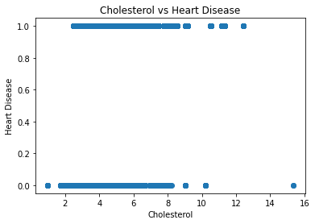
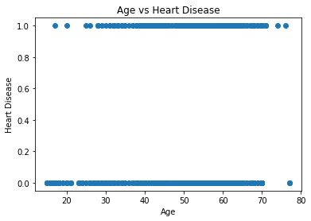
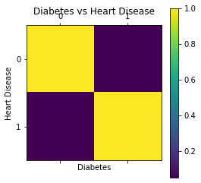
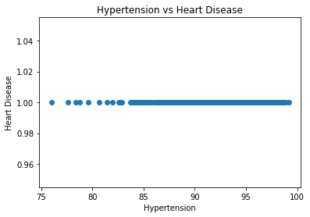
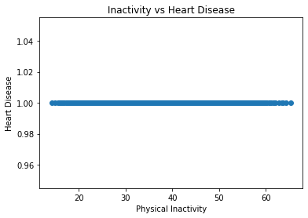

Linear Regression
Notes:
As a way to determine the initial viability of the hypotheses, I ran a linear regression model to determine the correlation between each of the risk factors and heart disease. Unfortunately, because our diagnosis is binary, the regression analysis did not show very promising results. In particular, the last 3 graphs, since all of the patients in this dataset were heart disease positive. Because this was an initial analysis, we can look into different methods for extracting information from the data, starting with PCA.

Slide 23
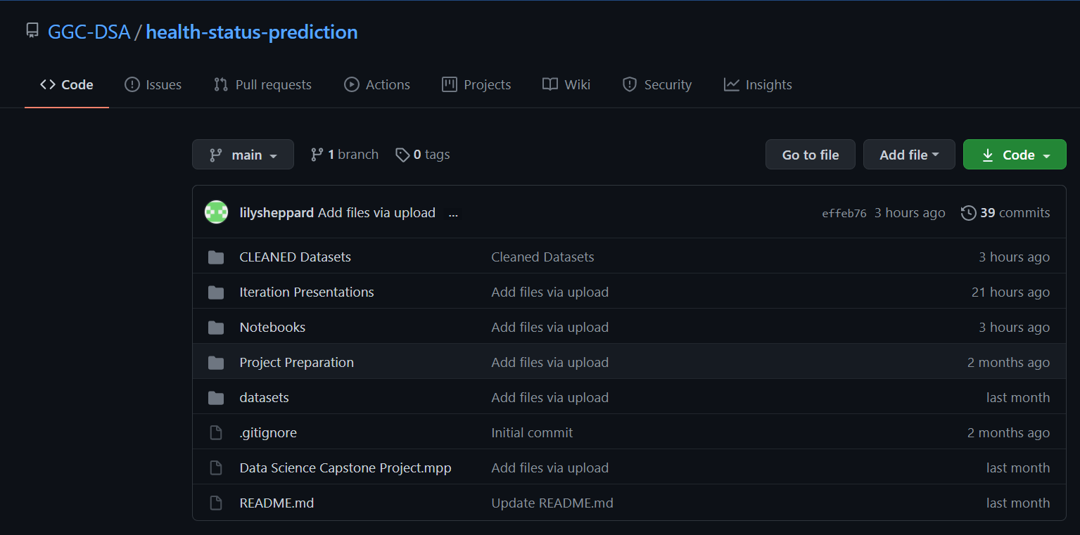
Github Repo updates!
Lily Sheppard
Notes:
I've added some additional folders including one for our Individual Notebooks,
our cleaned datasets, our iteration presentations and notes but the biggest update
I need to work on is to upload the details of our merging problem and the steps we
take to solve the problem!

